Slide 1
Object-Oriented Software Engineering
Practical Software Development using UML and Java
Chapter 5:
Modelling with Classes

Slide 2
5.1 What is UML?
The Unified Modelling Language is a standard graphical language for modelling object oriented software
  At the end of the 1980s and the beginning of 1990s, the first object-oriented development processes appeared
  The proliferation of methods and notations tended to cause considerable confusion
  Two important methodologists Rumbaugh and Booch decided to merge their approaches in 1994.
    They worked together at the Rational Software Corporation
  In 1995, another methodologist, Jacobson, joined the team
    His work focused on use cases
  In 1997 the Object Management Group (OMG) started the process of UML standardization
© Lethbridge/Laganière 2005
Chapter 5: Modelling with classes

Slide 3
UML diagrams
  Class diagrams
    describe classes and their relationships
  Interaction diagrams
    show the behaviour of systems in terms of how objects interact with each other
  State diagrams and activity diagrams
    show how systems behave internally
  Component and deployment diagrams
    show how the various components of systems are arranged logically and physically
© Lethbridge/Laganière 2005
Chapter 5: Modelling with classes

Slide 4
UML features
  It has detailed semantics
  It has extension mechanisms
  It has an associated textual language
    Object Constraint Language (OCL)
The objective of UML is to assist in software development
    It is not a methodology
© Lethbridge/Laganière 2005
Chapter 5: Modelling with classes

Slide 5
What constitutes a good model?
A model should
  use a standard notation
  be understandable by clients and users
  lead software engineers to have insights about the system
  provide abstraction
Models are used:
  to help create designs
  to permit analysis and review of those designs.
  as the core documentation describing the system.
© Lethbridge/Laganière 2005
Chapter 5: Modelling with classes

Slide 6
5.2 Essentials of UML Class Diagrams
The main symbols shown on class diagrams are:
  Classes
      represent the types of data themselves
  Associations
      represent linkages between instances of classes
  Attributes
      are simple data found in classes and their instances
  Operations
      represent the functions performed by the classes and their instances
  Generalizations
      group classes into inheritance hierarchies
© Lethbridge/Laganière 2005
Chapter 5: Modelling with classes

Slide 7
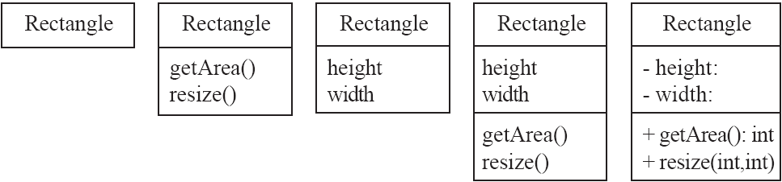
Classes
A class is simply represented as a box with the name of the class inside
  The diagram may also show the attributes and operations
  The complete signature of an operation is:
    operationName(parameterName: parameterType …): returnType
© Lethbridge/Laganière 2005
Chapter 5: Modelling with classes

Slide 8
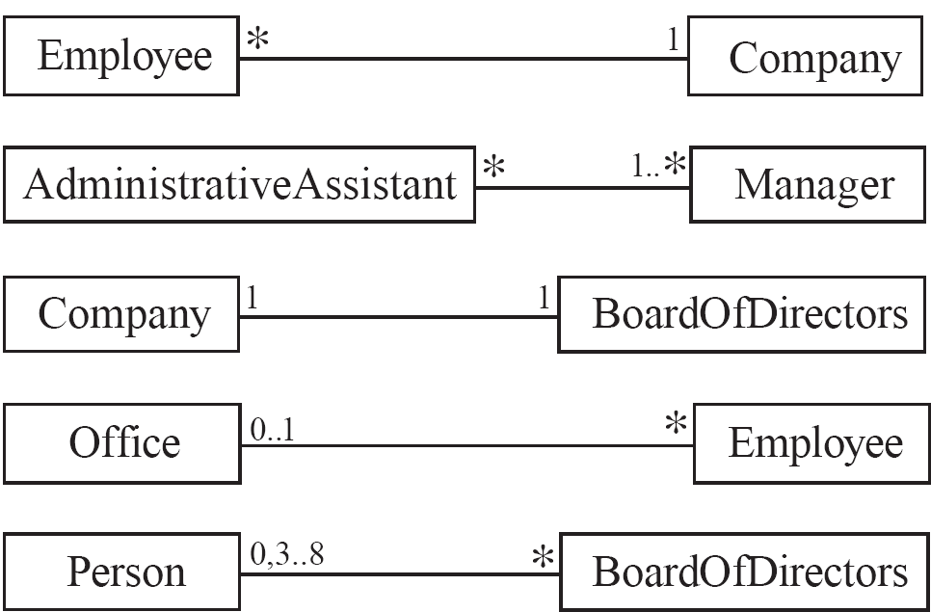
5.3 Associations and Multiplicity
An association is used to show how two classes are related to each other
  Symbols indicating multiplicity are shown at each end of the association
© Lethbridge/Laganière 2005
Chapter 5: Modelling with classes

Slide 9
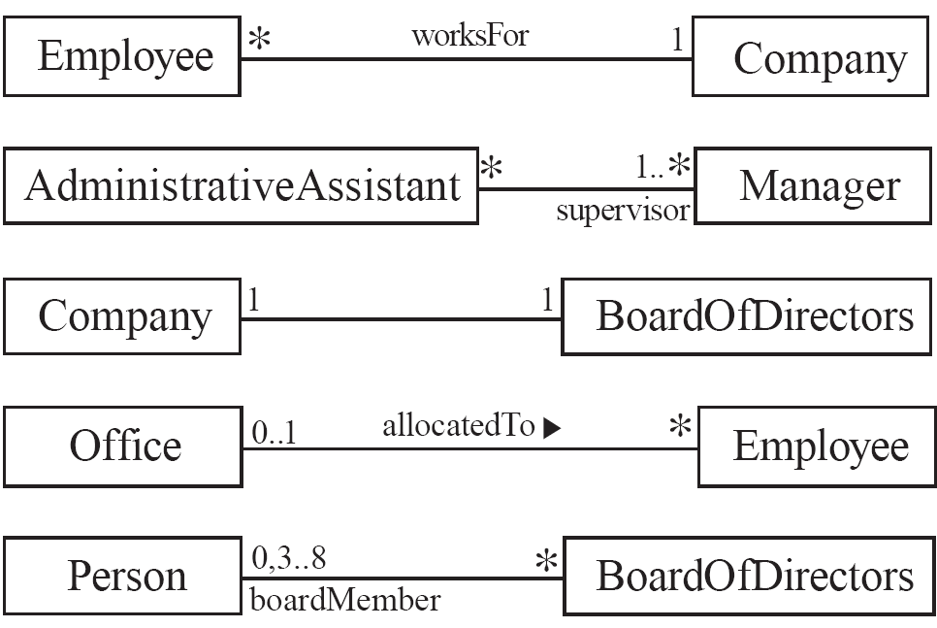
Labelling associations
  Each association can be labelled, to make explicit the nature of the association
© Lethbridge/Laganière 2005
Chapter 5: Modelling with classes

Slide 10
Analyzing and validating associations
  Many-to-one
    A company has many employees,
    An employee can only work for one company.
      This company will not store data about the moonlighting activities of employees!
    A company can have zero employees
      E.g. a ‘shell’ company
    It is not possible to be an employee unless you work for a company
Employee
*
worksFor
1
Company
© Lethbridge/Laganière 2005
Chapter 5: Modelling with classes

Slide 11
Analyzing and validating associations
  Many-to-many
    An assistant can work for many managers
    A manager can have many assistants
    Assistants can work in pools
    Managers can have a group of assistants
    Some managers might have zero assistants.
    Is it possible for an assistant to have, perhaps temporarily, zero managers?
*
1..*
*
*
*
*
Assistant
*
Manager
supervisor
Open in Umple
© Lethbridge/Laganière 2005
Chapter 5: Modelling with classes

Slide 12
Analyzing and validating associations
  One-to-one
    For each company, there is exactly one board of directors
    A board is the board of only one company
    A company must always have a board
    A board must always be of some company
1
1
Open in Umple
© Lethbridge/Laganière 2005
Chapter 5: Modelling with classes

Slide 13
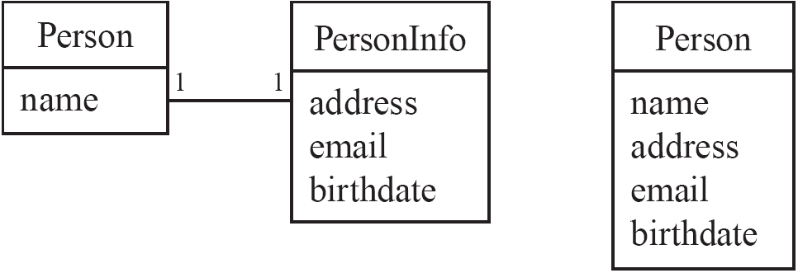
Analyzing and validating associations
Avoid unnecessary one-to-one associations
Avoid this do this
© Lethbridge/Laganière 2005
Chapter 5: Modelling with classes

Slide 14
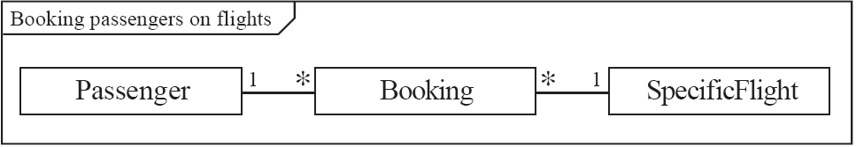
A more complex example
  A booking is always for exactly one passenger
    no booking with zero passengers
    a booking could never involve more than one passenger.
  A Passenger can have any number of Bookings
    a passenger could have no bookings at all
    a passenger could have more than one booking
  The frame around this diagram is an optional feature that any UML 2.0 may possess.
© Lethbridge/Laganière 2005
Chapter 5: Modelling with classes

Slide 15
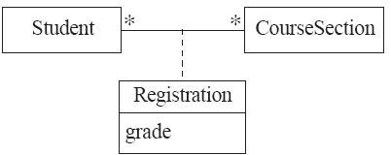

Association classes
  Sometimes, an attribute that concerns two associated classes cannot be placed in either of the classes
  The following are equivalent
Open in Umple and extended example
© Lethbridge/Laganière 2005
Chapter 5: Modelling with classes

Slide 16
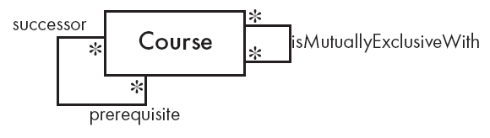
Reflexive associations
  It is possible for an association to connect a class to itself
Open in Umple
© Lethbridge/Laganière 2005
Chapter 5: Modelling with classes

Slide 17

Directionality in associations
Associations are by default bi-directional
It is possible to limit the direction of an association by adding an arrow at one end
Open in Umple
© Lethbridge/Laganière 2005
Chapter 5: Modelling with classes

Slide 18
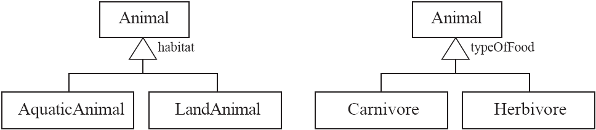
5.4 Generalization
Specializing a superclass into two or more subclasses
  A generalization set is a labeled group of generalizations with a common superclass
  The label (sometimes called the discriminator) describes the criteria used in the specialization
© Lethbridge/Laganière 2005
Chapter 5: Modelling with classes

Slide 19
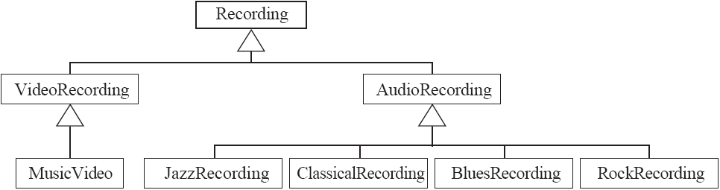
Avoiding unnecessary generalizations
Inappropriate hierarchy of
classes, which should be
instances
© Lethbridge/Laganière 2005
Chapter 5: Modelling with classes

Slide 20
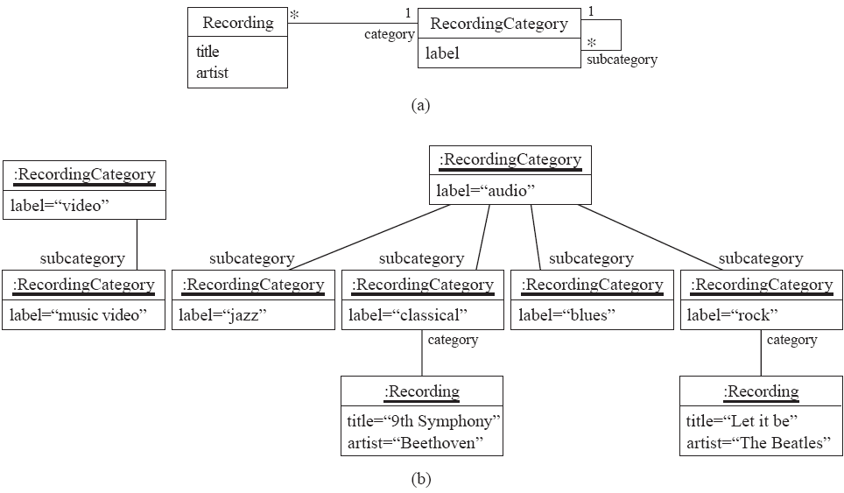
Avoiding unnecessary generalizations (cont)
Open in Umple
Improved class diagram, with its corresponding instance diagram
© Lethbridge/Laganière 2005
Chapter 5: Modelling with classes

Slide 21
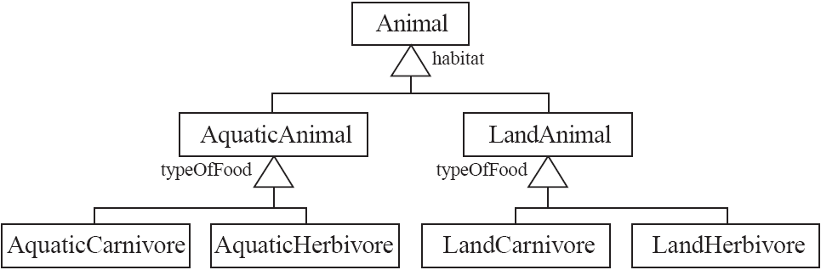
Handling multiple discriminators
  Creating higher-level generalization
© Lethbridge/Laganière 2005
Chapter 5: Modelling with classes

Slide 22
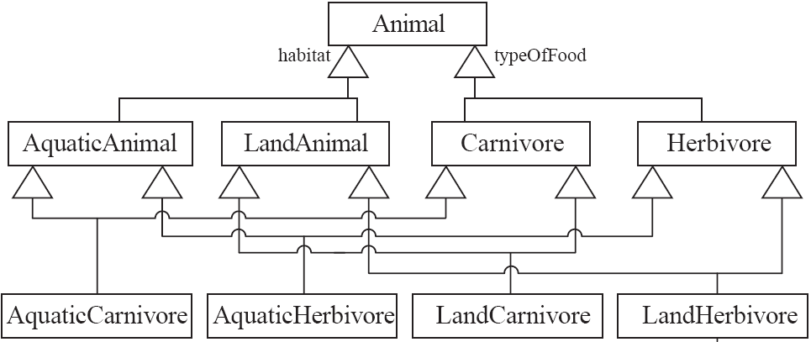
Handling multiple discriminators
  Using multiple inheritance
  Using the Player-Role pattern (in Chapter 6)
© Lethbridge/Laganière 2005
Chapter 5: Modelling with classes

Slide 23
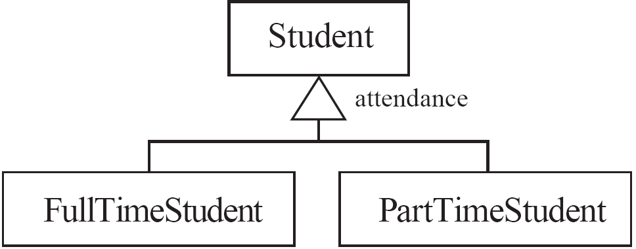
Avoiding having instances change class
  An instance should never need to change class
© Lethbridge/Laganière 2005
Chapter 5: Modelling with classes

Slide 24
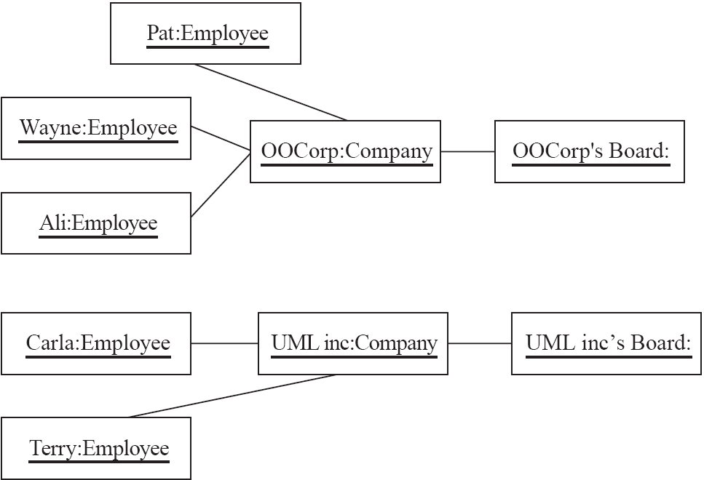
5.5 Object Diagrams
  A link is an instance of an association
    In the same way that we say an object is an instance of a class
© Lethbridge/Laganière 2005
Chapter 5: Modelling with classes

Slide 25
Associations versus generalizations in object diagrams
  Associations describe the relationships that will exist between instances at run time.
    When you show an instance diagram generated from a class diagram, there will be an instance of both classes joined by an association
  Generalizations describe relationships between classes in class diagrams.
    They do not appear in instance diagrams at all.
    An instance of any class should also be considered to be an instance of each of that class’s superclasses
© Lethbridge/Laganière 2005
Chapter 5: Modelling with classes

Slide 26
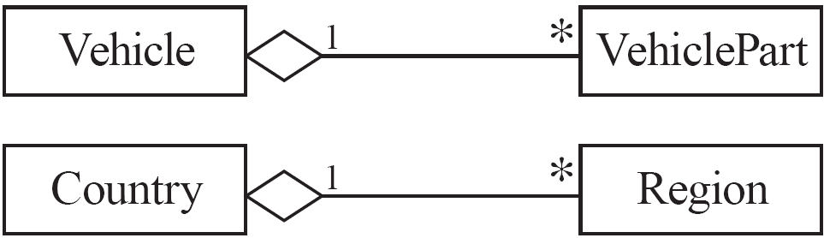
5.6 More Advanced Features: Aggregation
  Aggregations are special associations that represent ‘part-whole’ relationships.
    The ‘whole’ side is often called the assembly or the aggregate
    This symbol is a shorthand notation association named isPartOf
© Lethbridge/Laganière 2005
Chapter 5: Modelling with classes

Slide 27
When to use an aggregation
As a general rule, you can mark an association as an aggregation if the following are true:
  You can state that
    the parts ‘are part of’ the aggregate
    or the aggregate ‘is composed of’ the parts
  When something owns or controls the aggregate, then they also own or control the parts
© Lethbridge/Laganière 2005
Chapter 5: Modelling with classes

Slide 28

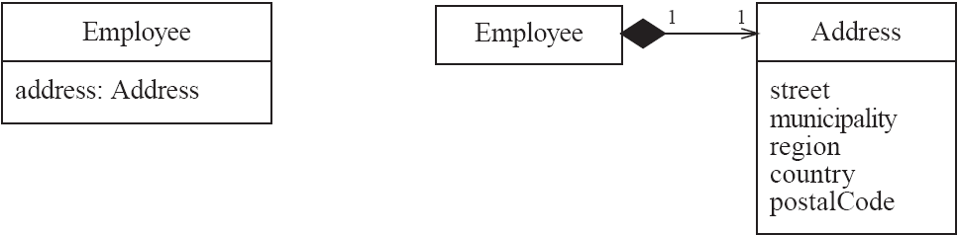
Composition
  A composition is a strong kind of aggregation
    if the aggregate is destroyed, then the parts are destroyed as well
  Two alternatives for addresses
© Lethbridge/Laganière 2005
Chapter 5: Modelling with classes

Slide 29
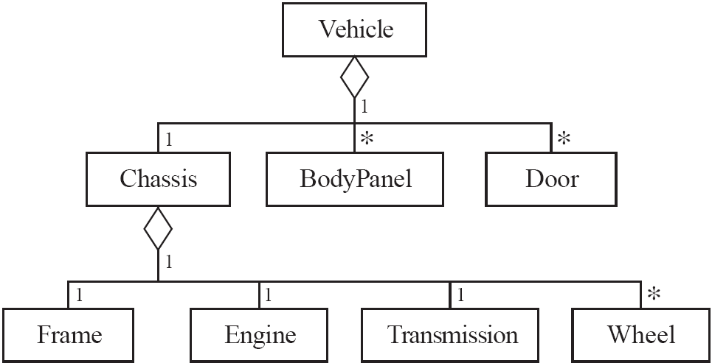
Aggregation hierarchy
© Lethbridge/Laganière 2005
Chapter 5: Modelling with classes

Slide 30

Propagation
  A mechanism where an operation in an aggregate is implemented by having the aggregate perform that operation on its parts
  At the same time, properties of the parts are often propagated back to the aggregate
  Propagation is to aggregation as inheritance is to generalization.
    The major difference is:
      inheritance is an implicit mechanism
      propagation has to be programmed when required
© Lethbridge/Laganière 2005
Chapter 5: Modelling with classes

Slide 31
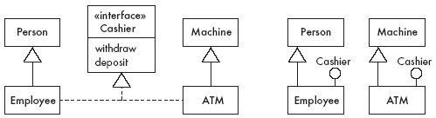
Interfaces
An interface describes a portion of the visible behaviour of a set of objects.
  An interface is similar to a class, except it lacks instance variables and implemented methods
© Lethbridge/Laganière 2005
Chapter 5: Modelling with classes

Slide 32
Notes and descriptive text
  Descriptive text and other diagrams
    Embed your diagrams in a larger document
    Text can explain aspects of the system using any notation you like
    Highlight and expand on important features, and give rationale
  Notes:
    A note is a small block of text embedded in a UML diagram
    It acts like a comment in a programming language
© Lethbridge/Laganière 2005
Chapter 5: Modelling with classes

Slide 33
5.7 Object Constraint Language (OCL)
OCL is a specification language designed to formally specify constraints in software modules
  An OCL expression simply specifies a logical fact (a constraint) about the system that must remain true
  A constraint cannot have any side-effects
    it cannot compute a non-Boolean result nor modify any data.
  OCL statements in class diagrams can specify what the values of attributes and associations must be
© Lethbridge/Laganière 2005
Chapter 5: Modelling with classes

Slide 34
OCL statements
OCL statements can be built from:
  References to role names, association names, attributes and the results of operations
  The logical values true and false
  Logical operators such as and, or, =, >, < or <> (not equals)
  String values such as: ‘a string’
  Integers and real numbers
  Arithmetic operations *, /, +, -
© Lethbridge/Laganière 2005
Chapter 5: Modelling with classes

Slide 35
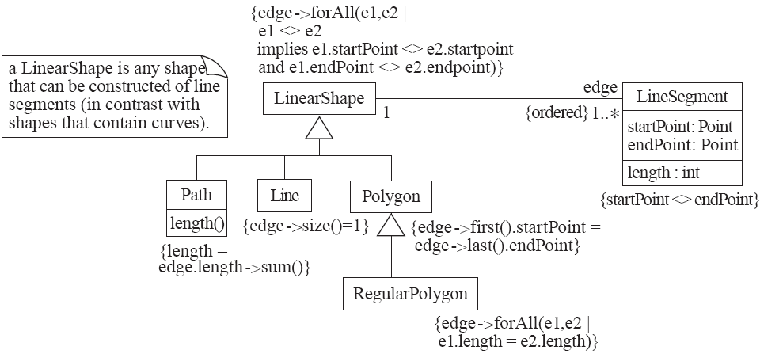
An example: constraints on Polygons
© Lethbridge/Laganière 2005
Chapter 5: Modelling with classes

Slide 36
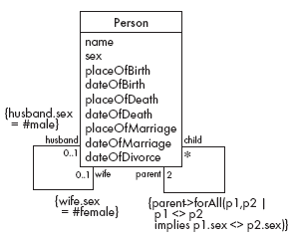
5.8 Detailed Example: A Class Diagram for Genealogy
  Problems
    A person must have two parents
    Marriages not properly accounted for
© Lethbridge/Laganière 2005
Chapter 5: Modelling with classes

Slide 37
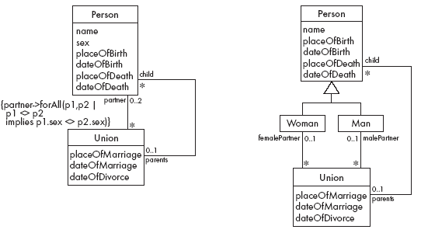
Genealogy example: Possible solutions
Open in Umple
© Lethbridge/Laganière 2005
Chapter 5: Modelling with classes

Slide 38
5.9 The Process of Developing Class Diagrams
You can create UML models at different stages and with different purposes and levels of details
  Exploratory domain model:
    Developed in domain analysis to learn about the domain
  System domain model:
    Models aspects of the domain represented by the system
  System model:
    Includes also classes used to build the user interface and system architecture
© Lethbridge/Laganière 2005
Chapter 5: Modelling with classes

Slide 39
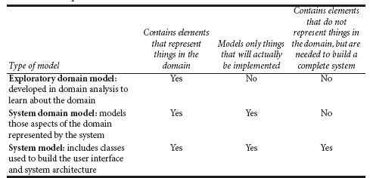
System domain model vs System model
© Lethbridge/Laganière 2005
Chapter 5: Modelling with classes

Slide 40
System domain model vs System model
  The system domain model omits many classes that are needed to build a complete system
    Can contain less than half the classes of the system.
    Should be developed to be used independently of particular sets of
      user interface classes
      architectural classes
  The complete system model includes
    The system domain model
    User interface classes
    Architectural classes
    Utility classes
© Lethbridge/Laganière 2005
Chapter 5: Modelling with classes

Slide 41
Suggested sequence of activities
  Identify a first set of candidate classes
  Add associations and attributes
  Find generalizations
  List the main responsibilities of each class
  Decide on specific operations
  Iterate over the entire process until the model is satisfactory
    Add or delete classes, associations, attributes, generalizations, responsibilities or operations
    Identify interfaces
    Apply design patterns (Chapter 6)
Don’t be too disorganized. Don’t be too rigid either.
© Lethbridge/Laganière 2005
Chapter 5: Modelling with classes

Slide 42
Identifying classes
  When developing a domain model you tend to discover classes
  When you work on the user interface or the system architecture, you tend to invent classes
    Needed to solve a particular design problem
    (Inventing may also occur when creating a domain model)
  Reuse should always be a concern
    Frameworks
    System extensions
    Similar systems
© Lethbridge/Laganière 2005
Chapter 5: Modelling with classes

Slide 43
A simple technique for discovering domain classes
  Look at a source material such as a description of requirements
  Extract the nouns and noun phrases
  Eliminate nouns that:
    are redundant
    represent instances
    are vague or highly general
    not needed in the application
  Pay attention to classes in a domain model that represent types of users or other actors
© Lethbridge/Laganière 2005
Chapter 5: Modelling with classes

Slide 44
Identifying associations and attributes
  Start with classes you think are most central and important
  Decide on the clear and obvious data it must contain and its relationships to other classes.
  Work outwards towards the classes that are less important.
  Avoid adding many associations and attributes to a class
    A system is simpler if it manipulates less information
© Lethbridge/Laganière 2005
Chapter 5: Modelling with classes

Slide 45
Tips about identifying and specifying valid associations
  An association should exist if a class
      possesses
      controls
      is connected to
      is related to
      is a part of
      has as parts
      is a member of, or
      has as members
  some other class in your model
  Specify the multiplicity at both ends
  Label it clearly.
© Lethbridge/Laganière 2005
Chapter 5: Modelling with classes

Slide 46
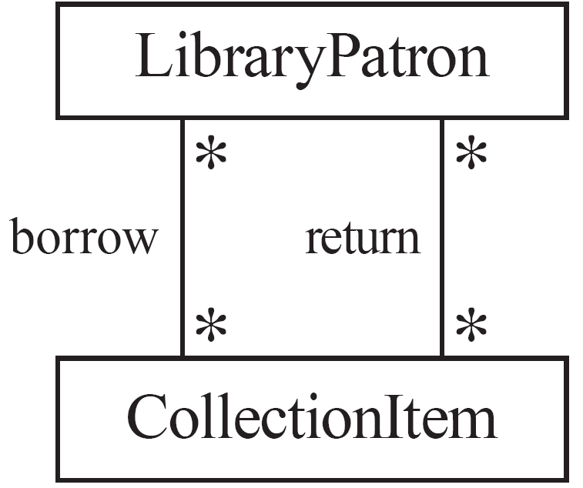
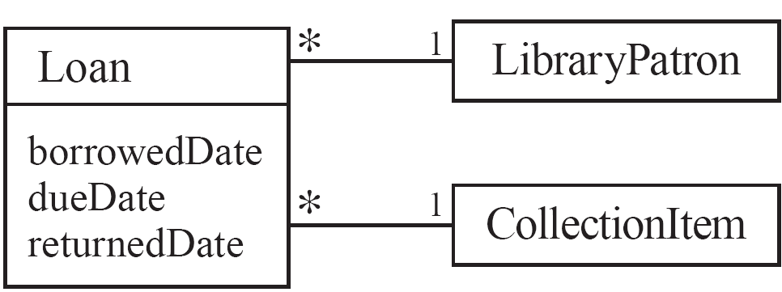
Actions versus associations
  A common mistake is to represent actions as if they were associations
Better: The
borrow
operation creates a
Loan
, and
Bad, due to the use of associations
the
return
operation sets the
returnedDate
that are actions
attribute.
© Lethbridge/Laganière 2005
Chapter 5: Modelling with classes

Slide 47
Identifying attributes
  Look for information that must be maintained about each class
  Several nouns rejected as classes, may now become attributes
  An attribute should generally contain a simple value
    E.g. string, number
© Lethbridge/Laganière 2005
Chapter 5: Modelling with classes

Slide 48
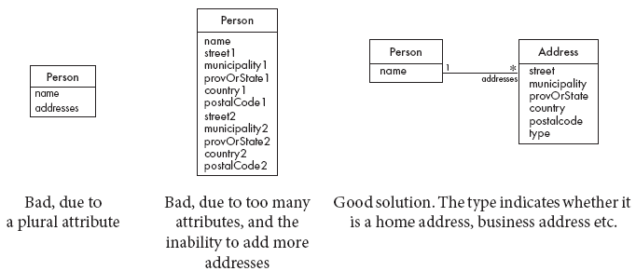
Tips about identifying and specifying valid attributes
  It is not good to have many duplicate attributes
  If a subset of a class’s attributes form a coherent group, then create a distinct class containing these attributes
© Lethbridge/Laganière 2005
Chapter 5: Modelling with classes

Slide 49
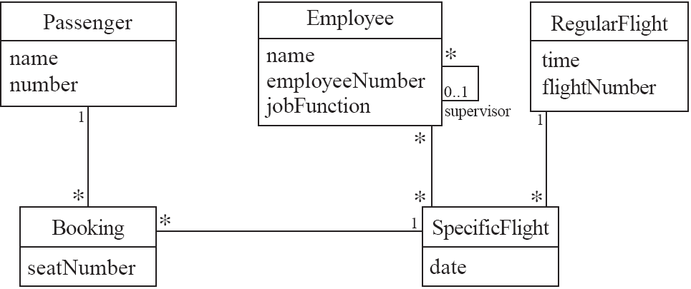
An example (attributes and associations)
© Lethbridge/Laganière 2005
Chapter 5: Modelling with classes

Slide 50
Identifying generalizations and interfaces
  There are two ways to identify generalizations:
    bottom-up
      Group together similar classes creating a new superclass
    top-down
      Look for more general classes first, specialize them if needed
  Create an interface, instead of a superclass if
    The classes are very dissimilar except for having a few operations in common
    One or more of the classes already have their own superclasses
    Different implementations of the same class might be available
© Lethbridge/Laganière 2005
Chapter 5: Modelling with classes

Slide 51
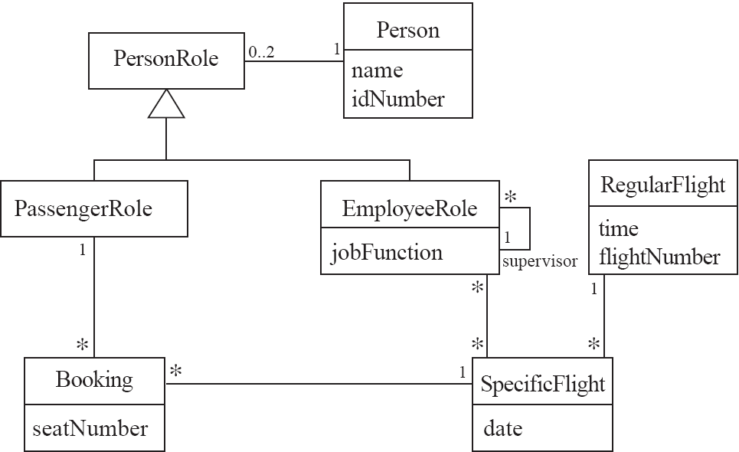
An example (generalization)
© Lethbridge/Laganière 2005
Chapter 5: Modelling with classes

Slide 52
Allocating responsibilities to classes
A responsibility is something that the system is required to do.
  Each functional requirement must be attributed to one of the classes
    All the responsibilities of a given class should be clearly related.
    If a class has too many responsibilities, consider splitting it into distinct classes
    If a class has no responsibilities attached to it, then it is probably useless
    When a responsibility cannot be attributed to any of the existing classes, then a new class should be created
  To determine responsibilities
    Perform use case analysis
    Look for verbs and nouns describing actions in the system description
© Lethbridge/Laganière 2005
Chapter 5: Modelling with classes

Slide 53
Categories of responsibilities
  Setting and getting the values of attributes
  Creating and initializing new instances
  Loading to and saving from persistent storage
  Destroying instances
  Adding and deleting links of associations
  Copying, converting, transforming, transmitting or outputting
  Computing numerical results
  Navigating and searching
  Other specialized work
© Lethbridge/Laganière 2005
Chapter 5: Modelling with classes

Slide 54
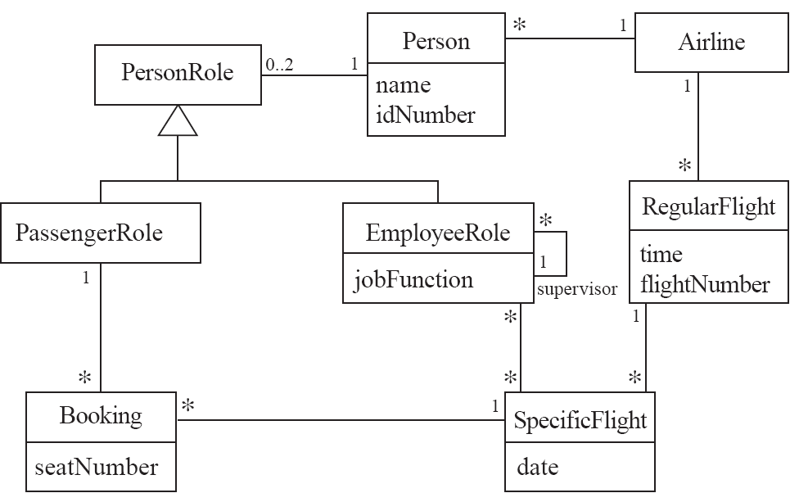
An example (responsibilities)
Creating a new regular flight
Searching for a flight
Modifying attributes of a flight
Creating a specific flight
Booking a passenger
Canceling a booking
© Lethbridge/Laganière 2005
Chapter 5: Modelling with classes

Slide 55
Prototyping a class diagram on paper
  As you identify classes, you write their names on small cards
  As you identify attributes and responsibilities, you list them on the cards
    If you cannot fit all the responsibilities on one card:
      this suggests you should split the class into two related classes.
  Move the cards around on a whiteboard to arrange them into a class diagram.
  Draw lines among the cards to represent associations and generalizations.
© Lethbridge/Laganière 2005
Chapter 5: Modelling with classes

Slide 56
Identifying operations
Operations are needed to realize the responsibilities of each class
  There may be several operations per responsibility
  The main operations that implement a responsibility are normally declared public
  Other methods that collaborate to perform the responsibility must be as private as possible
© Lethbridge/Laganière 2005
Chapter 5: Modelling with classes

Slide 57
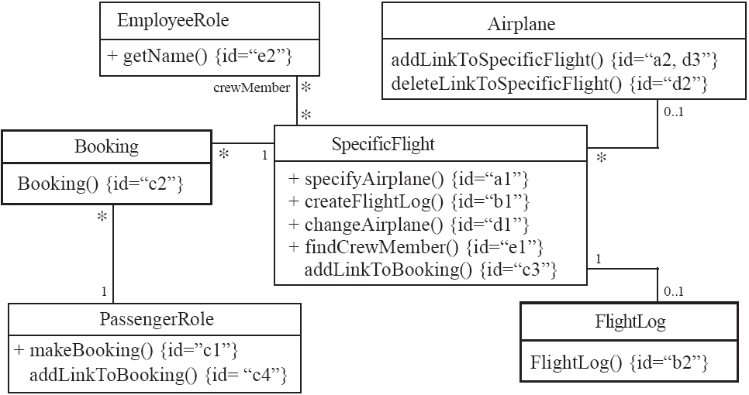
An example (class collaboration)
© Lethbridge/Laganière 2005
Chapter 5: Modelling with classes

Slide 58
Class collaboration ‘a’
SpecificFlight
*
0..1
Airplane
Making a bi-directional link between two existing objects;
e.g. adding a link between an instance of SpecificFlight and an instance of Airplane.
1. (public) The instance of SpecificFlight
    makes a one-directional link to the instance of Airplane
    then calls operation 2.
2. (non-public) The instance of Airplane
    makes a one-directional link back to the instance of SpecificFlight
© Lethbridge/Laganière 2005
Chapter 5: Modelling with classes

Slide 59
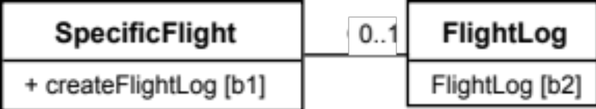
Class collaboration ‘b’
1
Creating an object and linking it to an existing object
e.g. creating a FlightLog, and linking it to a SpecificFlight.
1. (public) The instance of SpecificFlight
    calls the constructor of FlightLog (operation 2)
    then makes a one-directional link to the new instance of FlightLog.
2. (non-public) Class FlightLog’s constructor
    makes a one-directional link back to the instance of SpecificFlight.
© Lethbridge/Laganière 2005
Chapter 5: Modelling with classes

Slide 60
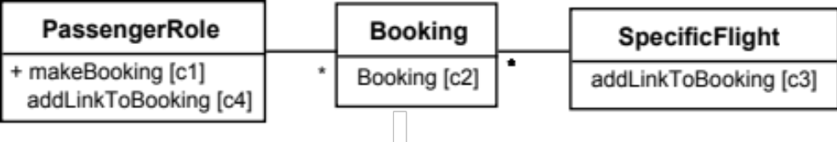
Class collaboration ‘c’
1
1
Creating an association class, given two existing objects
e.g. creating an instance of Booking, which will link a SpecificFlight to a PassengerRole.
1. (public) The instance of PassengerRole
    calls the constructor of Booking (operation 2).
2. (non-public) Class Booking’s constructor, among its other actions
    makes a one-directional link back to the instance of PassengerRole
    makes a one-directional link to the instance of SpecificFlight
    calls operations 3 and 4.
3. (non-public) The instance of SpecificFlight
    makes a one-directional link to the instance of Booking.
4. (non-public) The instance of PassengerRole
    makes a one-directional link to the instance of Booking.
© Lethbridge/Laganière 2005
Chapter 5: Modelling with classes

Slide 61
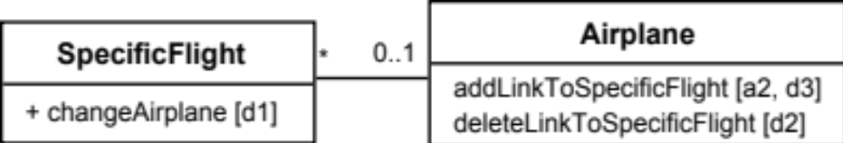
Class collaboration ‘d’
Changing the destination of a link
e.g. changing the Airplane of to a SpecificFlight, from airplane1 to airplane2
1. (public) The instance of SpecificFlight
    deletes the link to airplane1
    makes a one-directional link to airplane2
    calls operation 2
    then calls operation 3.
2. (non-public) airplane1
    deletes its one-directional link to the instance of SpecificFlight.
3. (non-public) airplane2
    makes a one-directional link to the instance of SpecificFlight.
© Lethbridge/Laganière 2005
Chapter 5: Modelling with classes

Slide 62
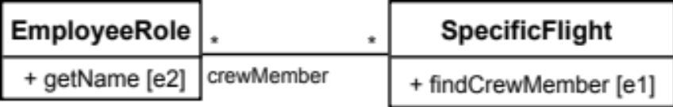
Class collaboration ‘e’
Searching for an associated instance
e.g. searching for a crew member associated with a SpecificFlight that has a certain name.
1. (public) The instance of SpecificFlight
    creates an Iterator over all the crewMember links of the SpecificFlight\
    for each of them call operation 2, until it finds a match.
2. (may be public) The instance of EmployeeRole returns its name.
© Lethbridge/Laganière 2005
Chapter 5: Modelling with classes

Slide 63
5.10 Implementing Class Diagrams in Java
  Attributes are implemented as instance variables
  Generalizations are implemented using extends
  Interfaces are implemented using implements
  Associations are normally implemented using instance variables
    Divide each two-way association into two one-way associations
      so each associated class has an instance variable.
    For a one-way association where the multiplicity at the other end is ‘one’ or ‘optional’
      declare a variable of that class (a reference)
    For a one-way association where the multiplicity at the other end is ‘many’:
      use a collection class implementing List, such as Vector
© Lethbridge/Laganière 2005
Chapter 5: Modelling with classes

Slide 64
Example: SpecificFlight
class SpecificFlight
{
private Calendar date;
private RegularFlight regularFlight;
...
// Constructor that should only be called from
// addSpecificFlight
SpecificFlight( Calendar aDate, RegularFlight aRegularFlight)
{
date = aDate;
regularFlight = aRegularFlight;
}
}
© Lethbridge/Laganière 2005
Chapter 5: Modelling with classes

Slide 65
Example: RegularFlight
class RegularFlight
{
private List specificFlights;
...
// Method that has primary responsibility
public void addSpecificFlight(Calendar aDate)
{
SpecificFlight newSpecificFlight;
newSpecificFlight = new SpecificFlight(aDate, this);
specificFlights.add(newSpecificFlight);
}
...
}
© Lethbridge/Laganière 2005
Chapter 5: Modelling with classes

Slide 66
5.11 Difficulties and Risks when creating class diagrams
  Modeling is particularly difficult skill
    Even excellent programmers have difficulty thinking at the appropriate level of abstraction
    Education traditionally focus more on design and programming than modeling
  Resolution:
    Ensure that tem members have adequate training
    Have experienced modeler as part of the team
    Review all models thoroughly
© Lethbridge/Laganière 2005
Chapter 5: Modelling with classes

